Slide 1
Exploratory Data Analysis Report

Slide 2
- A comprehensive report summarizing EDA findings. - Visualizations (e.g., plots, charts) to support your insights

Slide 3
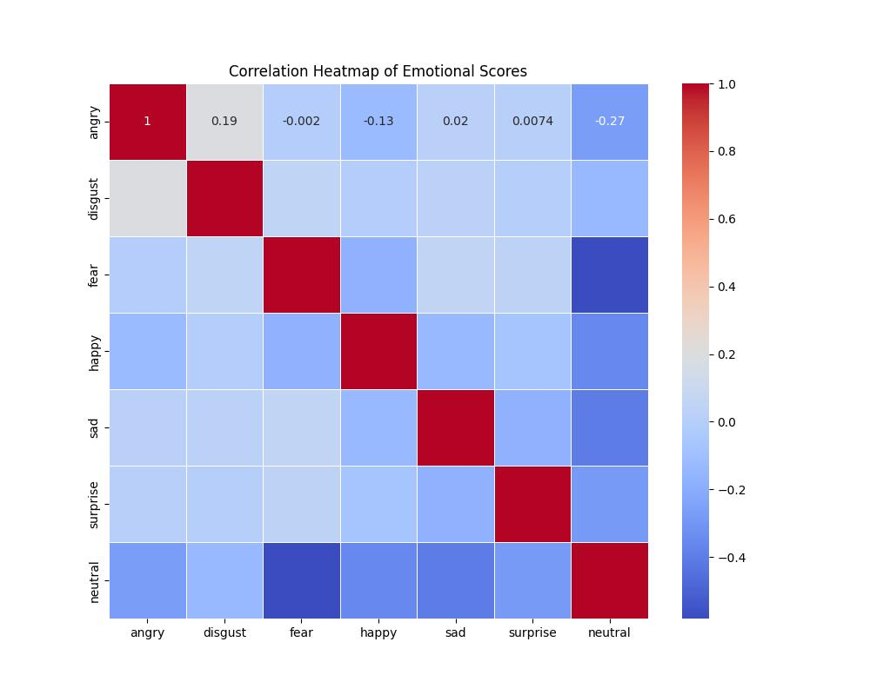
Correlation Heatmap of Emotion Scores

Slide 4
Explanation of Correlation Heatmap of Emotion Scores
The heatmap provides a visual representation of the relationships between different emotional scores. Each cell in the heatmap represents the correlation coefficient between two emotional scores.
Strong positive correlations (brighter colors) suggest that as one emotion score increases, the other tends to increase as well, while strong negative correlations(darker colors) suggest that as one emotion score increases, the other tends to decrease.
For example, if you notice a strong negative correlation between anger and happiness, you might hypothesize that candidates tend to express one emotion while suppressing the other.

Slide 5
Decreasing order of candidates exhibiting clear and concise communication from Transcript data.
CANDIDATE | CLEAR AND CONCISE SCORE
3 | 1.936561
2 | 1.882612
8 | 1.758261
9 | 1.729415
10 | 1.686597
1 | 1.624869
5 | 1.624709
6 | 1.434812
7 | 1.432687
4 | 1.418385
I defined a metric that combines the
"concise" score with factors like speech
speed and confidence then calculated a
composite score for each candidate, and
candidates with higher scores will be
considered more clear and concise.

Slide 6
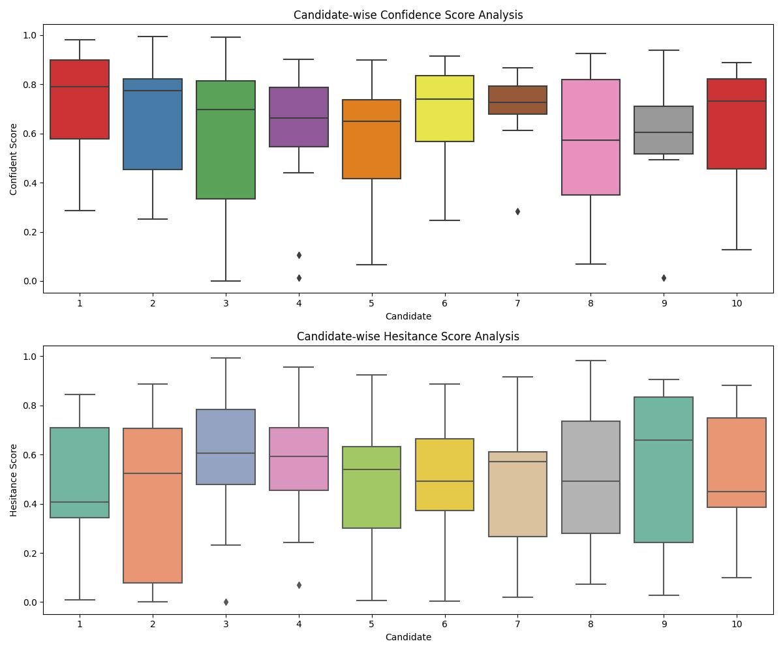
Analysis for Confidence Scores and Hesitance Scores
We can see from the plot that the standard
deviation of confident score of candidate 3 and 8 are
much Higher than other candidates , which implies
the fluctuation of these candidates in there
confidence Score during their video.
Similarly the standard deviation of hesitation
score of candidate 2 and 9 are much higher

Slide 7
How confident do candidates sound in their speech (based on the confidence score)
CANDIDATE | CONFIDENCE
1 | 0.733828
7 | 0.703714
2 | 0.684879
6 | 0.679755
4 | 0.621740
10 | 0.619852
9 | 0.591842
5 | 0.590094
3 | 0.573566
8 | 0.555011

Slide 8
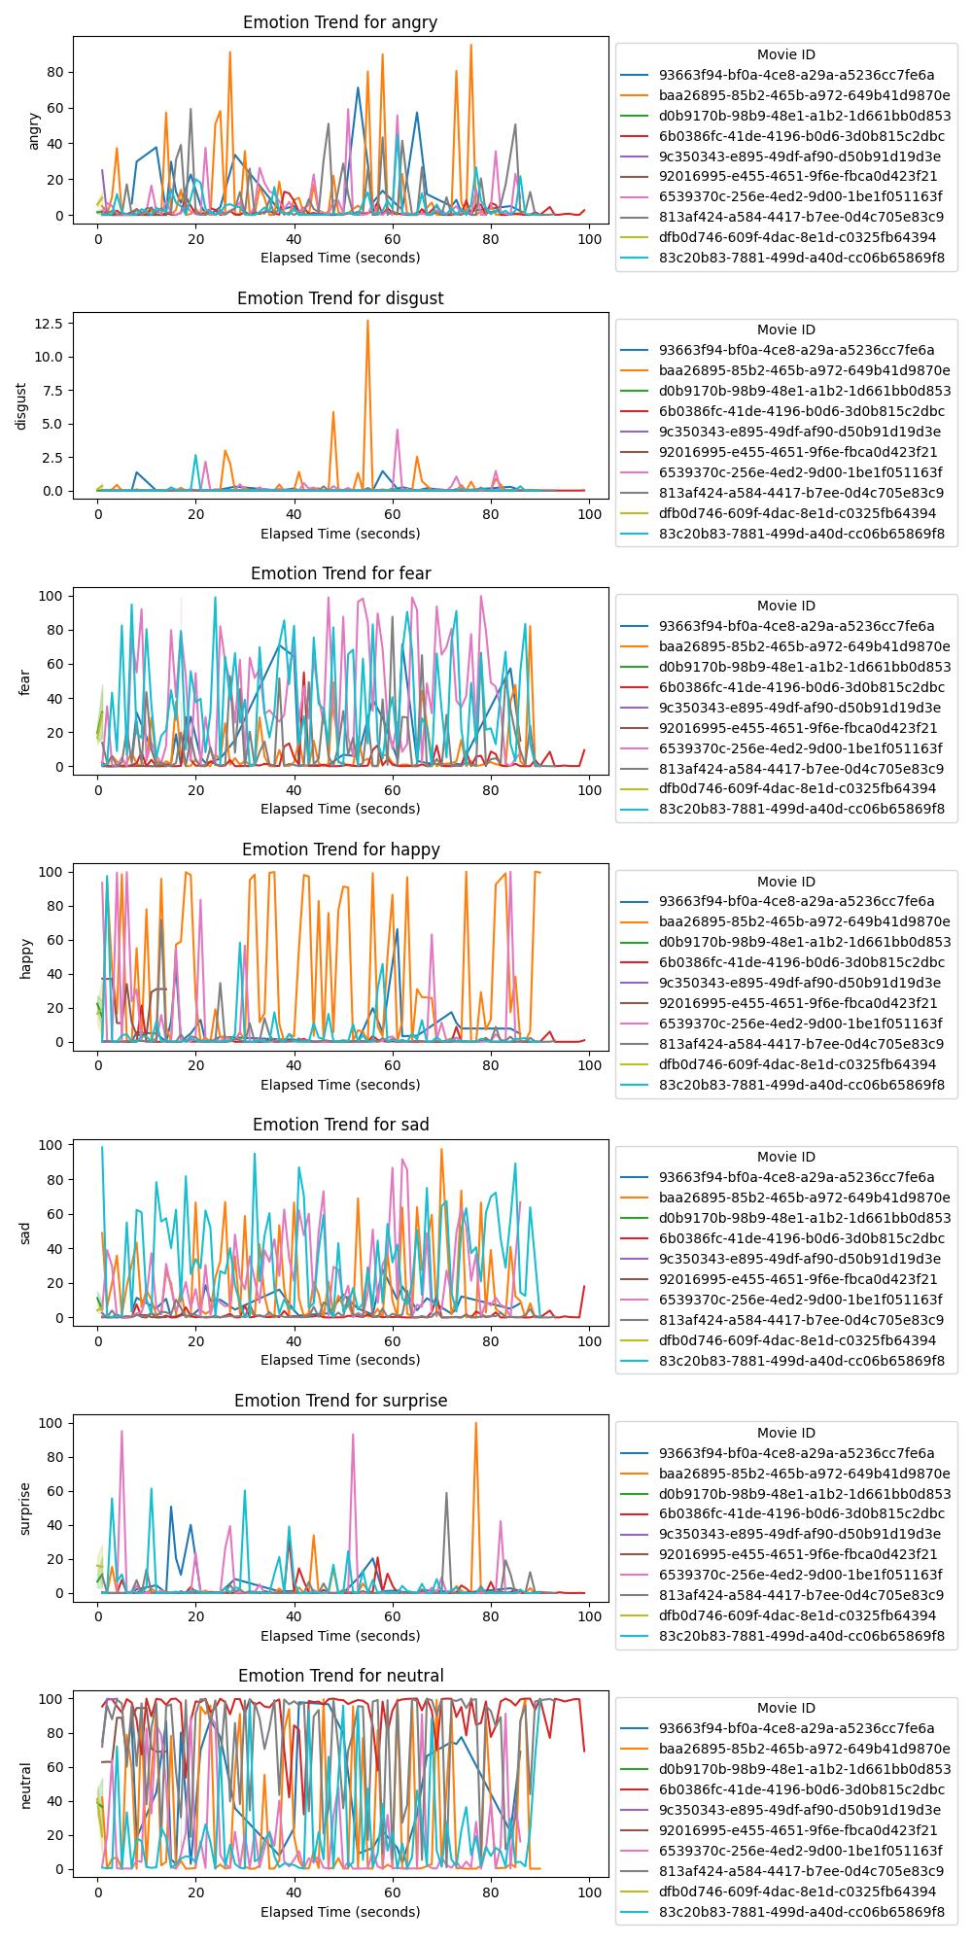
Emotion Trends Over Movies

Slide 9
decreasing order of candidates who appear more confident and enthusiastic than others
CANDIDATE | CONFIDENCE_ENTHUSIASM SCORE
1 | 0.626896
2 | 0.617602
7 | 0.607804
6 | 0.600426
9 | 0.557166
4 | 0.549295
3 | 0.523360
8 | 0.507966
5 | 0.505300
10 | 0.502114

Slide 10
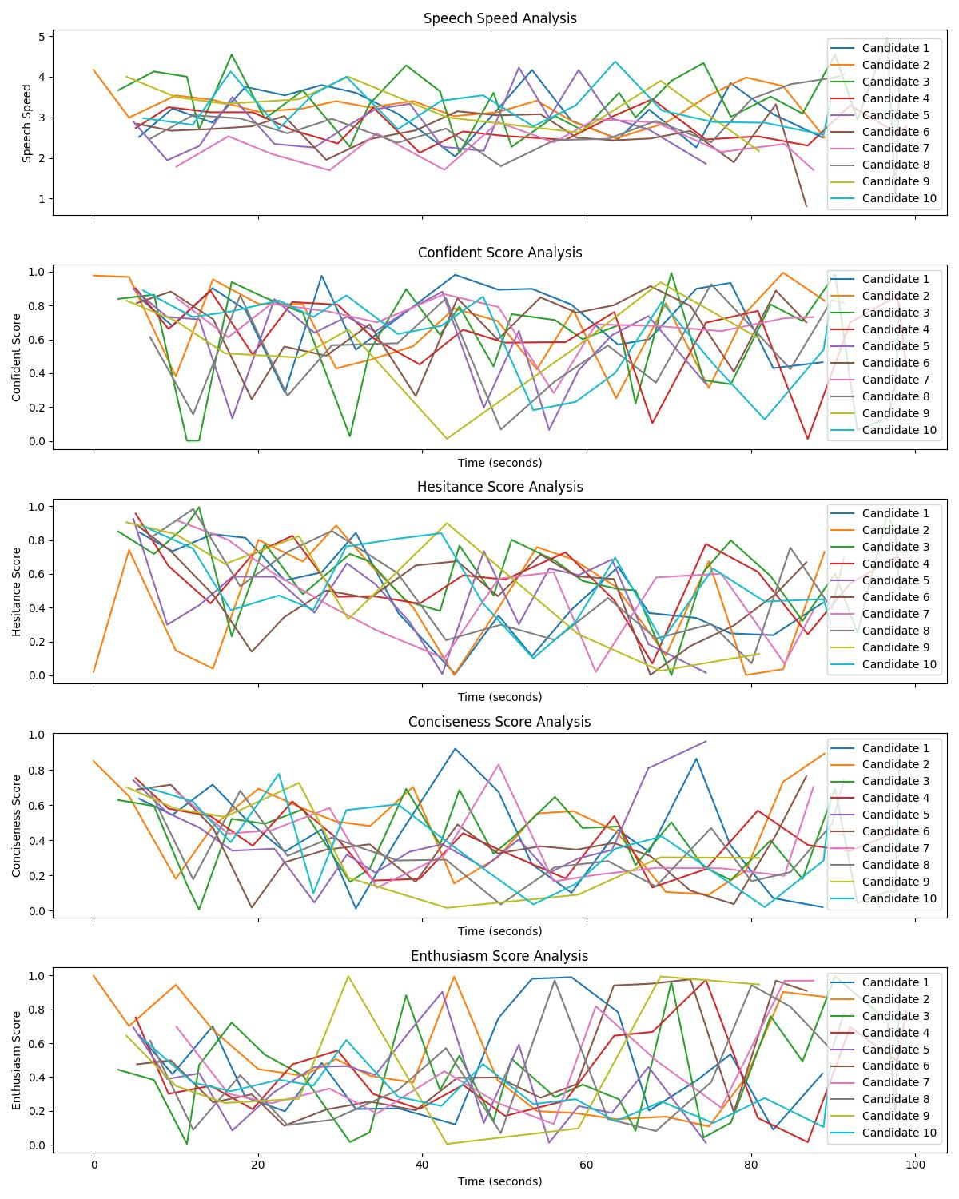
Patterns or Trends in Speech Speed, Confidence, Hesitance, Conciseness, or Enthusiasm

Slide 11
Analysis result on speech speed of different candidate
CANDIDATE | SPEECH SPEED STATUS
1 | Too fast
2 | Too fast
3 | Too fast and Too slow
4 | suitable
5 | Too fast and too slow
6 | Too slow
7 | Too slow
8 | Too slow and too fast
9 | Too fast
10 | Too fast
I set up the thresholds for acceptable speech
speed and then filter the candidates based
on those thresholds
Min threshold speed = 2.0
Max threshold speed=3.5

Slide 12
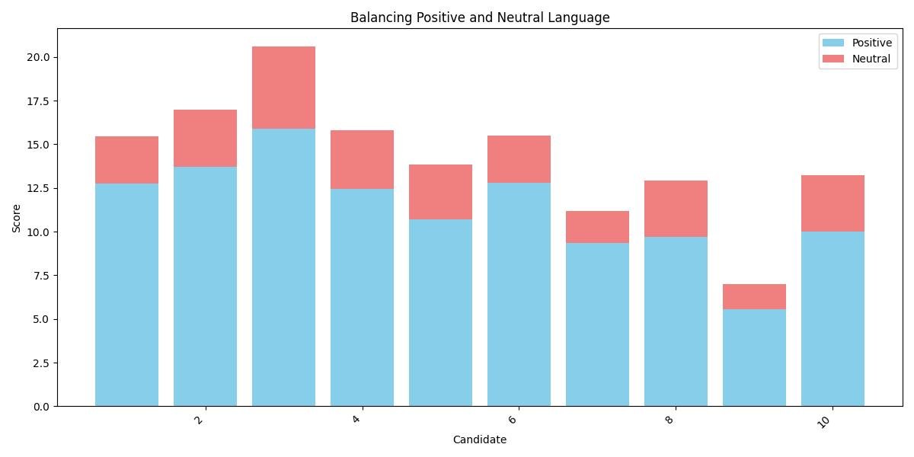
Balancing Positive and Negative Language

Slide 13
Explanation of Balancing Positive and Negative Language
Positive Score (Blue Bars): The blue bars represent the positive scores of each candidate. The height of each blue bar corresponds to the total positive score for that candidate.
Neutral Score (Red Bars): The red bars represent the neutral scores of each candidate. The height of each red bar corresponds to the total neutral score for that candidate.
If the red (neutral) bar is taller than the blue (positive) bar for a candidate, it indicates that the candidate used more neutral language than positive language in their speech. Conversely, if the blue bar is taller, it means the candidate used more positive language.

Slide 14
whether candidates are able to showcase creativity or adaptability in their speech
CANDIDATE | CREATIVITY AND ADAPTABILITY
1 | Showcase adaptability
2 | Showcase creativity and adaptability
3 | Neither creativity and adaptability
4 | Neither creativity and adaptability
5 | Showcase adaptability
6 | Showcase adaptability
7 | Showcase adaptability
8 | Neither creativity and adaptability
9 | Showcase creativity
10 | Neither creativity and adaptability
whether candidates are able to showcase
creativity or adaptability in their speech I
calculated a score that considers their
enthusiasm score (indicating creativity
or passion) and their hesitance score
(indicating adaptability or fluency).
A higher enthusiasm score suggests
creativity,while a lower hesitance score
suggests adaptability.

Slide 15
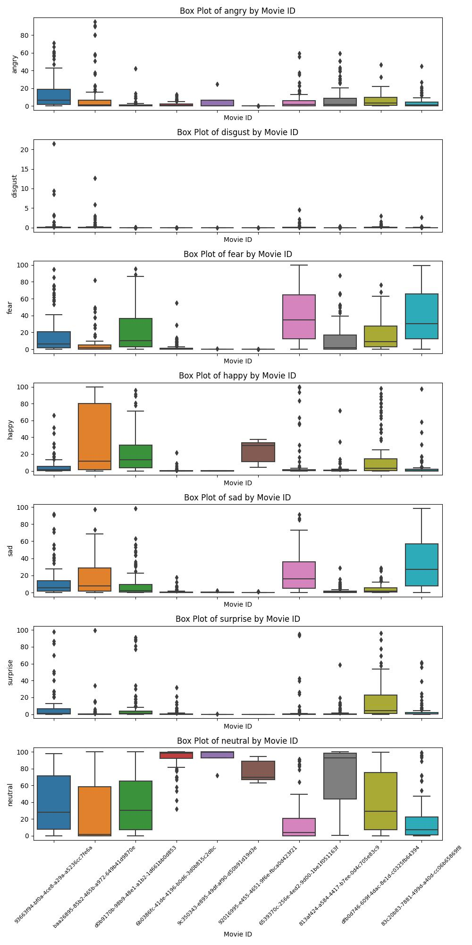
Analysis of Different Emotions on Different Movie IDs

Slide 16
candidates who show signs of hesitance in their speech
CANDIDATE | HESITATE SCORE
1 | Does not show hesitation
2 | Does not show hesitation
3 | Show hesitation
4 | Show hesitation
5 | Does not show hesitation
6 | Does not show hesitation
7 | Does not show hesitation
8 | Show hesitation
9 | Show hesitation
10 | Show hesitation

Slide 17
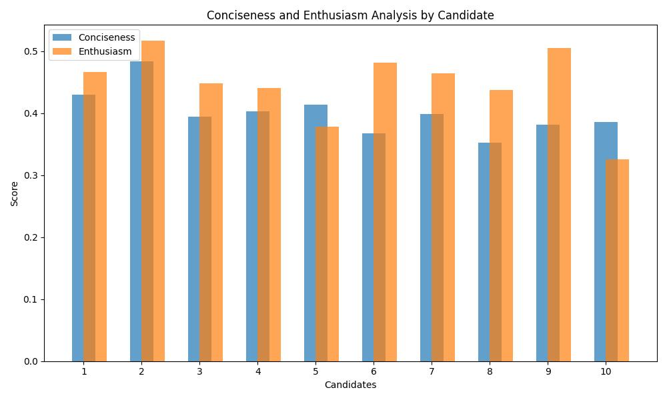
Conciseness and Enthusiasm Analysis by Candidate

Slide 18

Which candidate exhibited the most positive dominant emotion (e.g., happy) throughout their video - Candidate 2 has most positive dominant emotion with the movie id baa26895-85b2-a972-649b41d9870e Candidates who consistently display nervousness or discomfort? - Candidate 5 and 6 display nervousness or discomfort

Slide 19
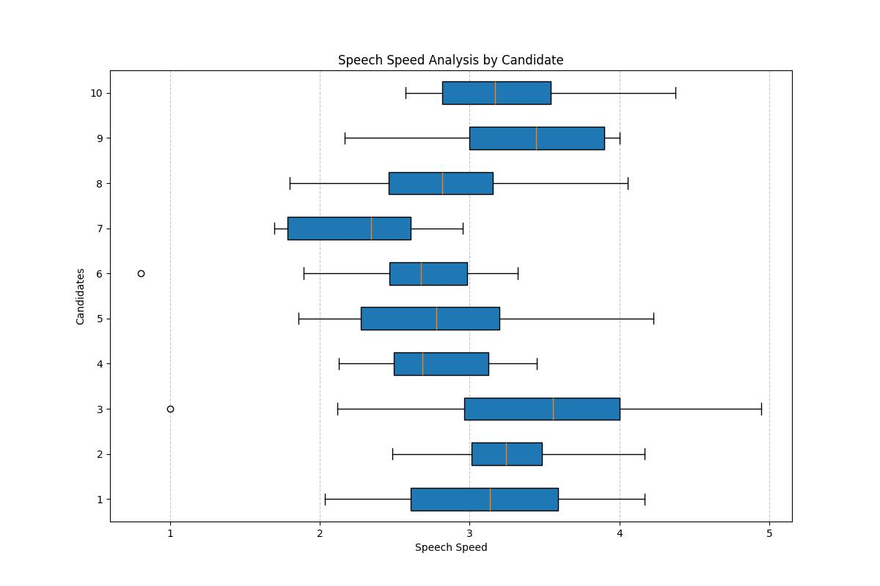
Speech Speed Analysis by Candidates

Slide 20
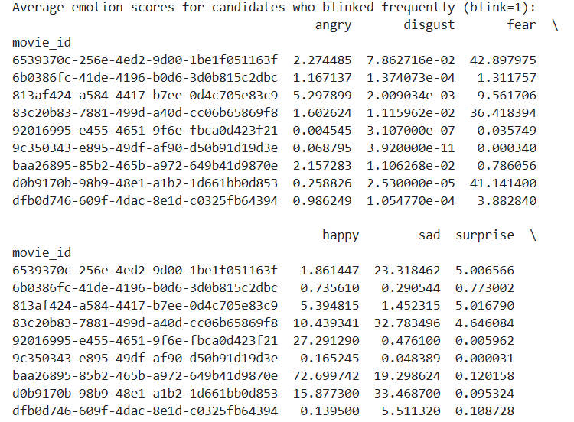
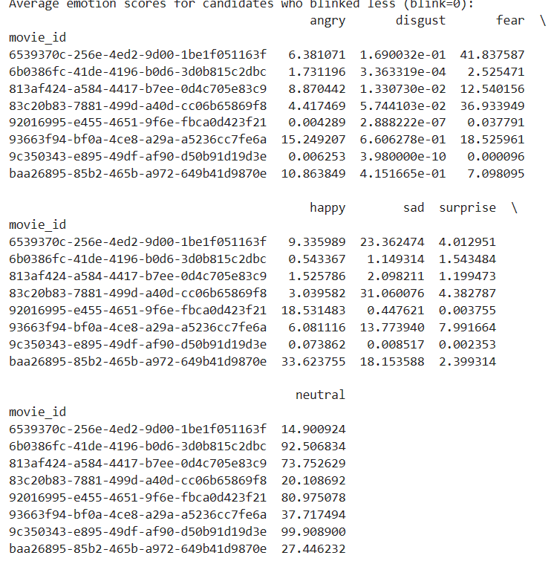
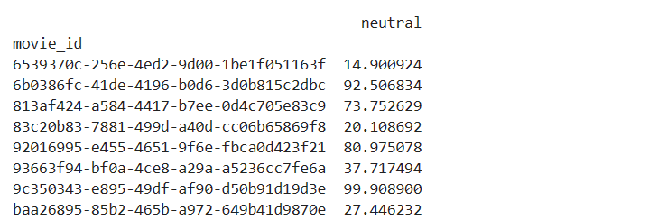
Did candidates who blinked more frequently perform differently from those who didn't blink as much?

Slide 21
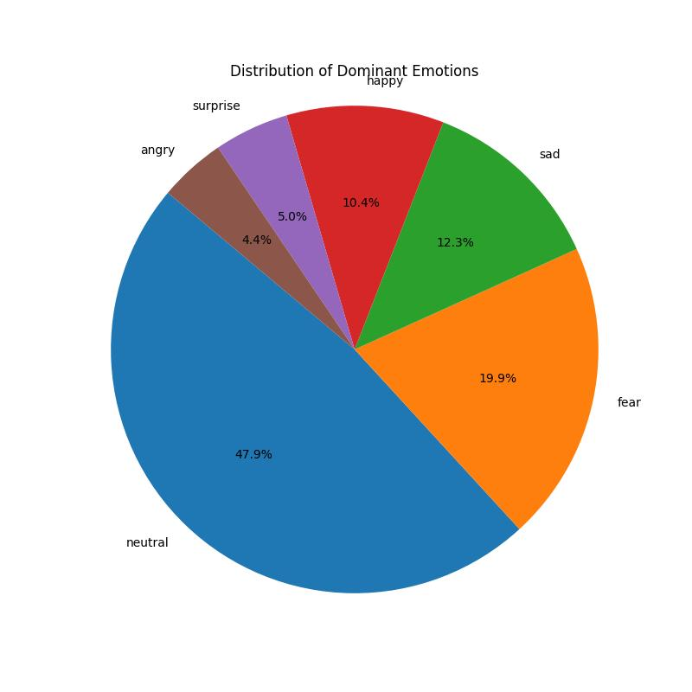
Distribution of Dominant Score

Slide 22
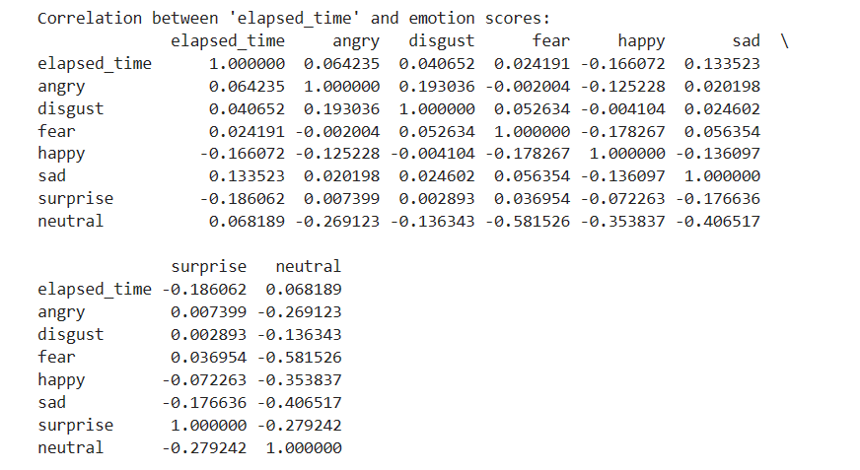
Correlation between the length of the video (elapsed_time) and the emotions expressed?

Slide 23
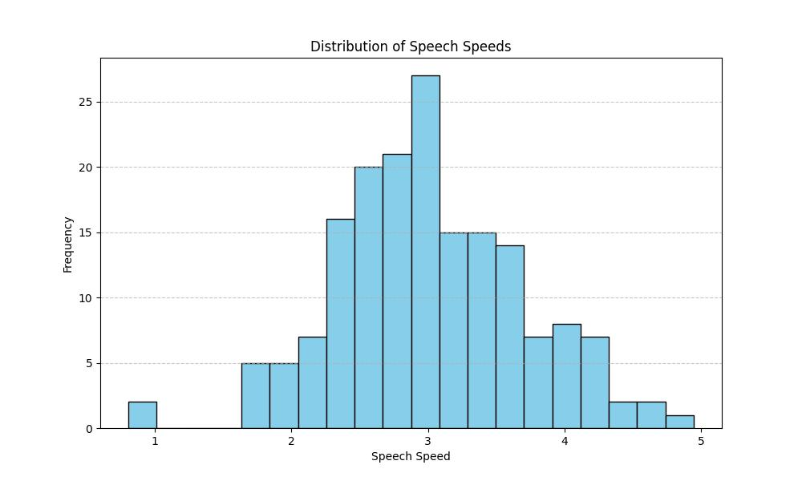
Speech Speed Distribution

Slide 24
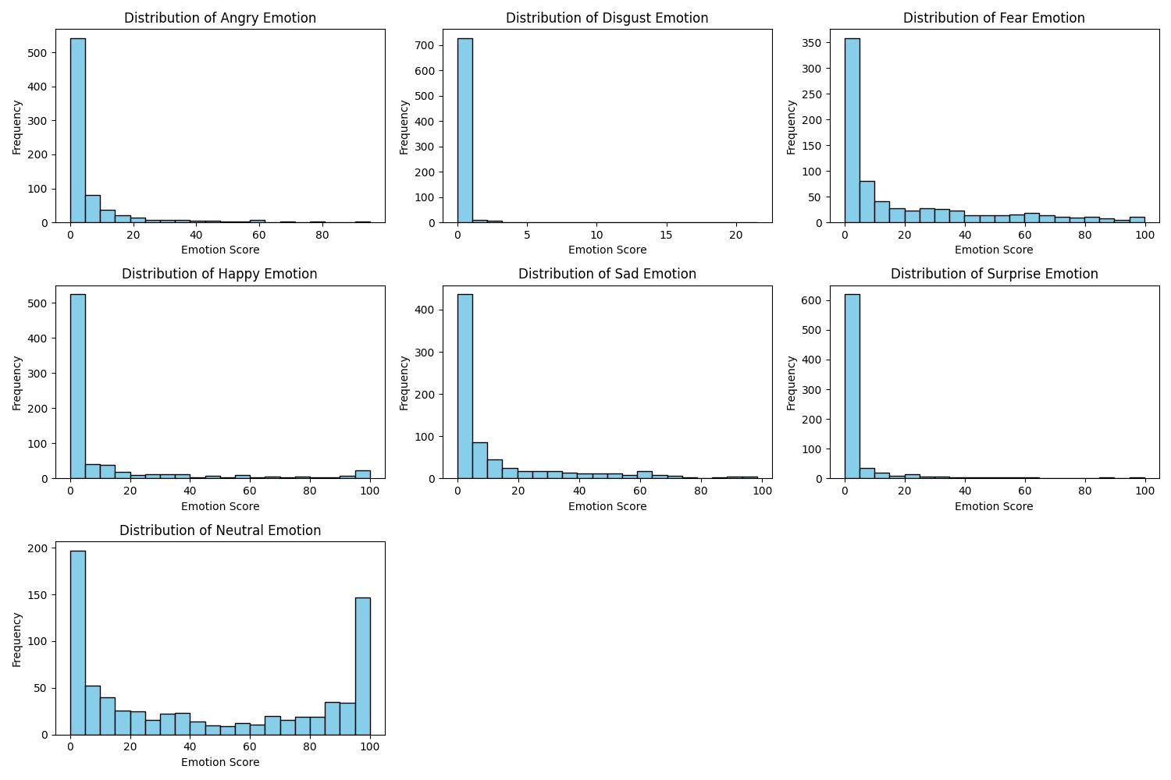
Plot of frequency V/S different emotions

Slide 25
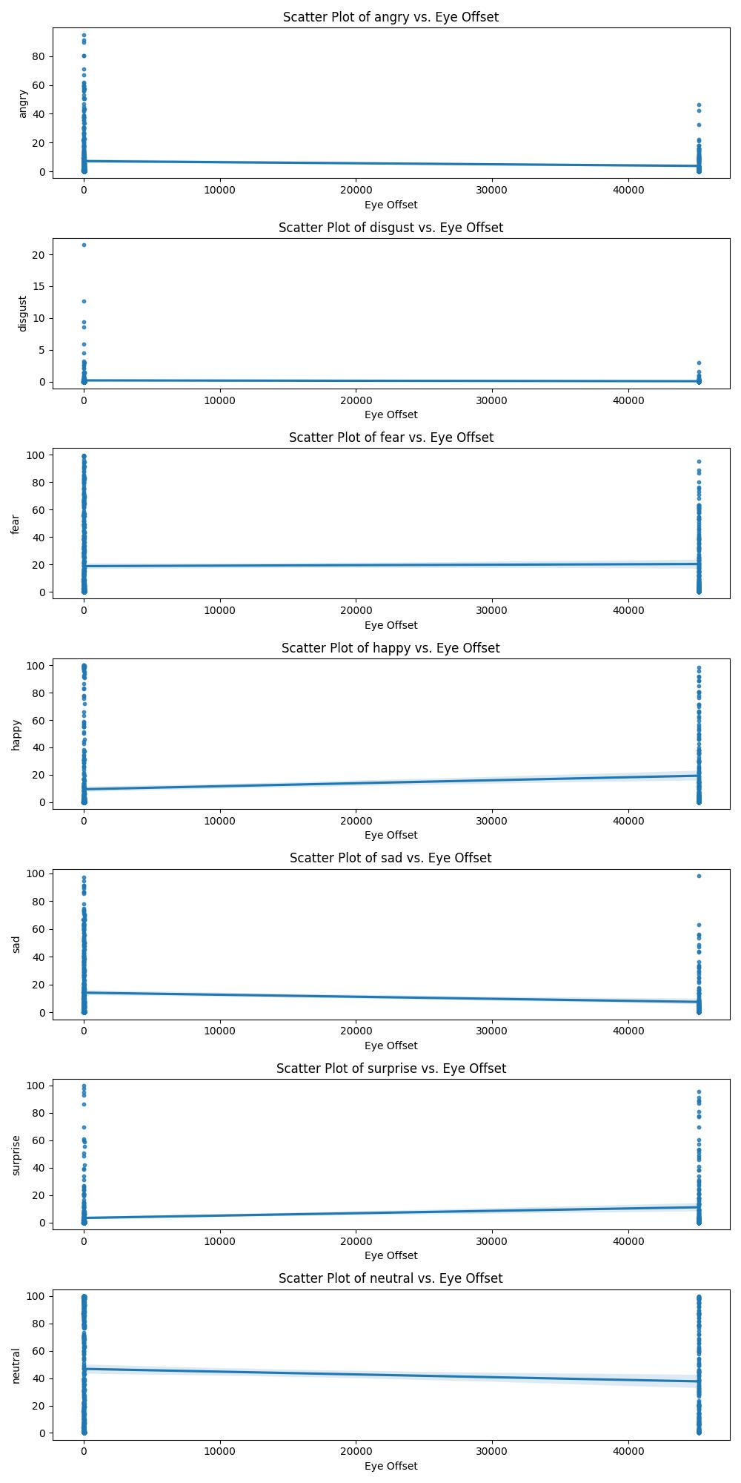
Plot of Emotion vs Eye Offset

Slide 26
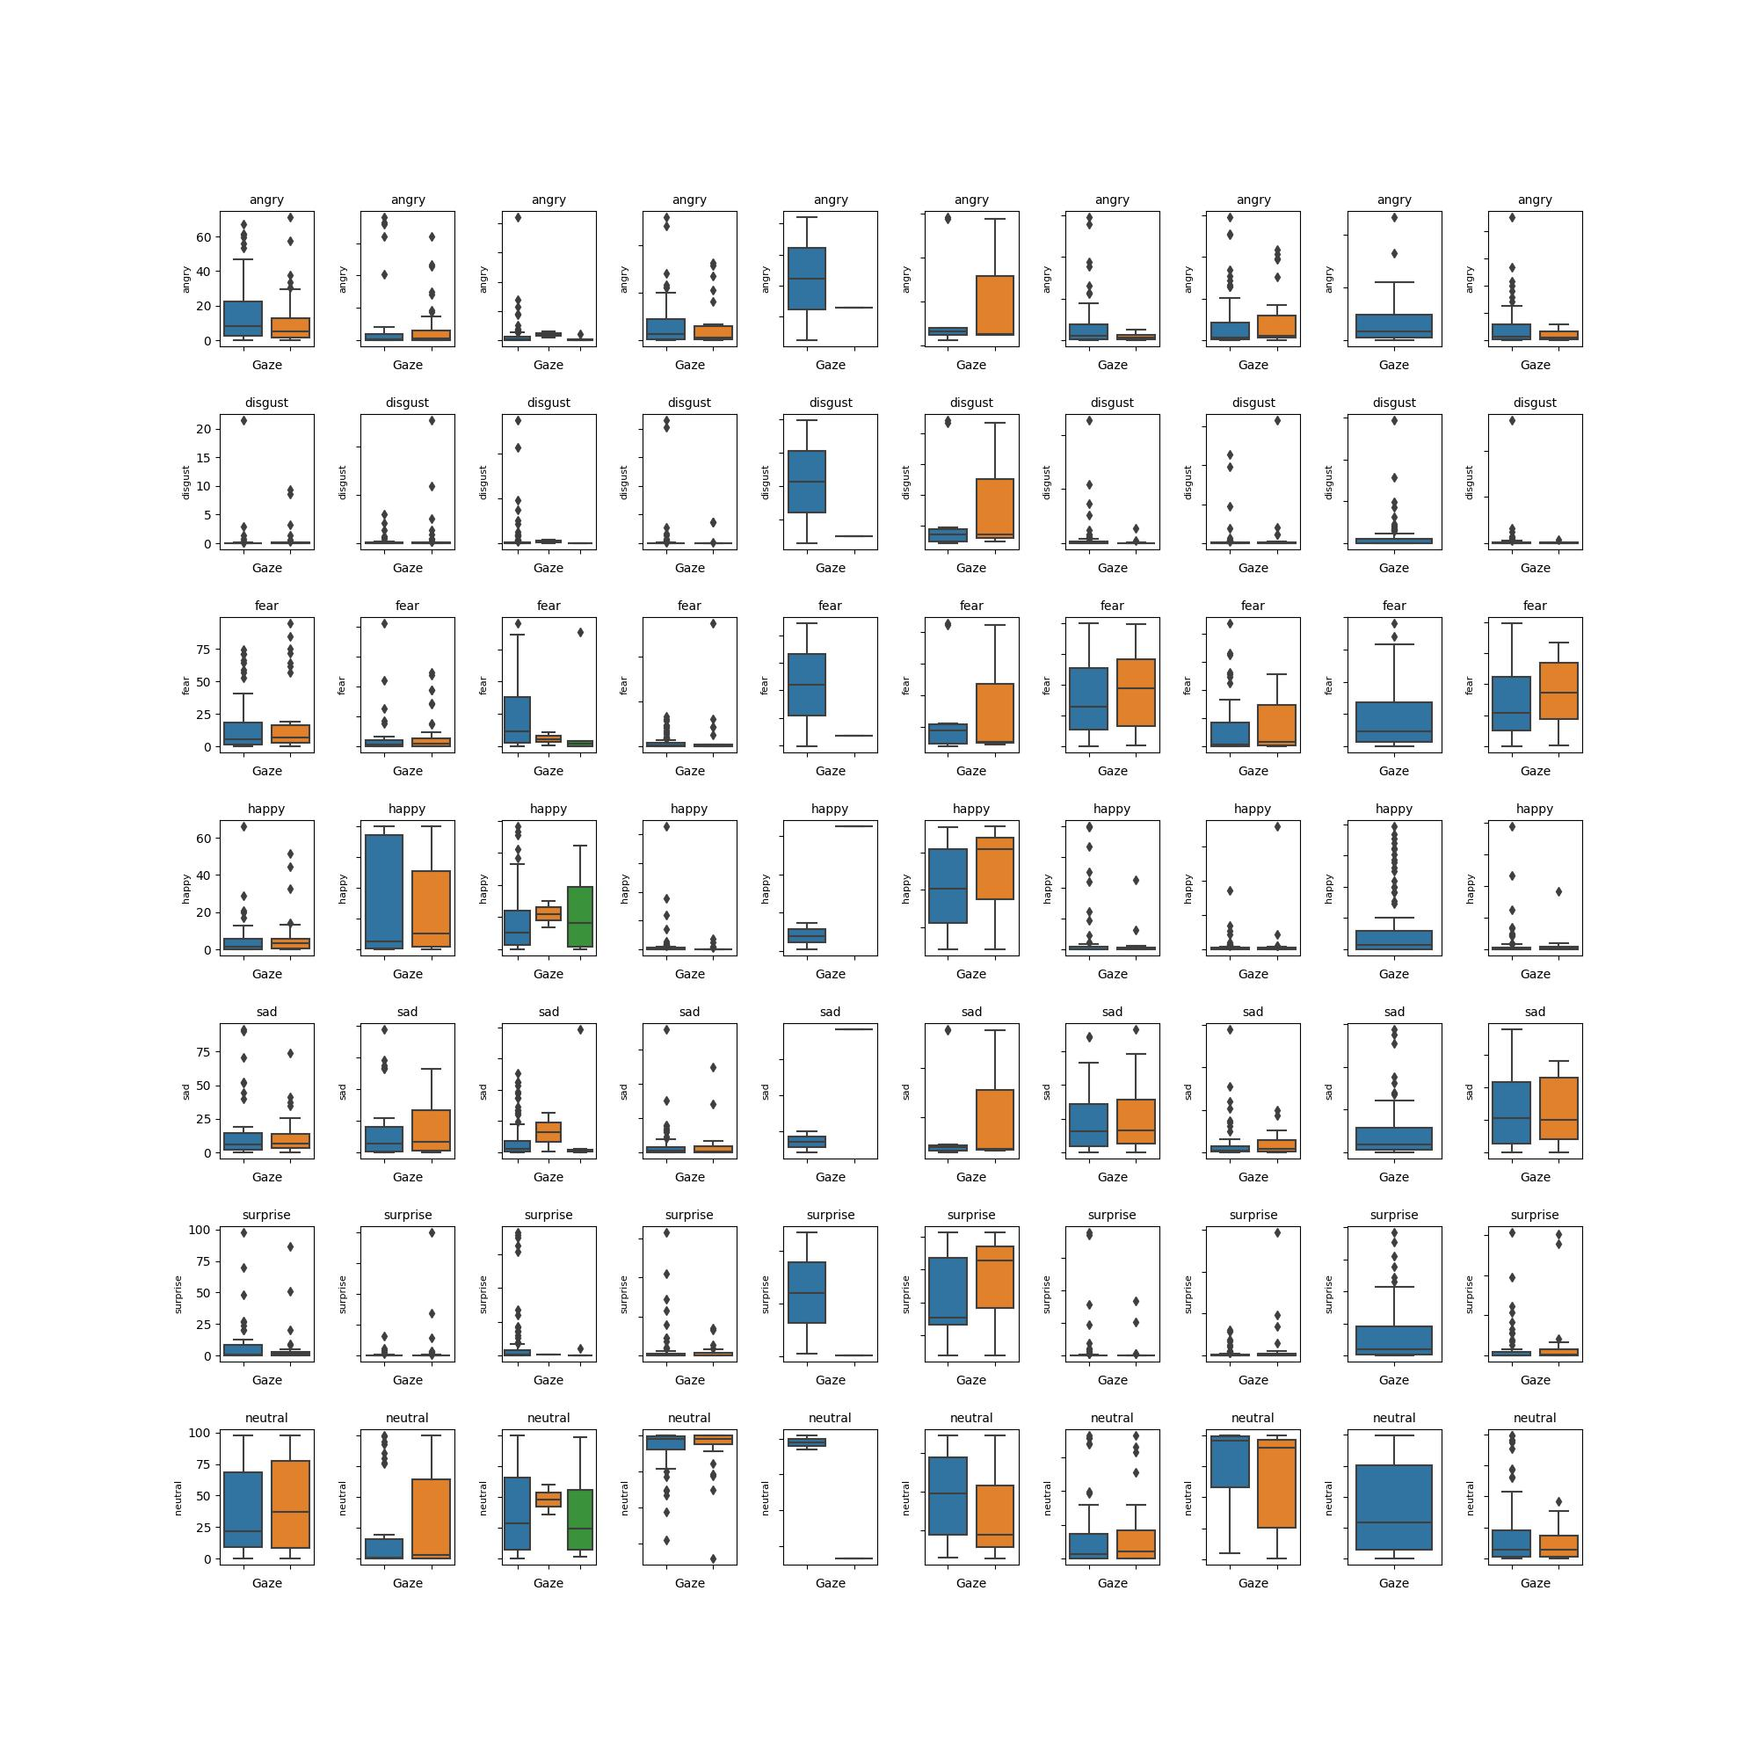
Plot of Emotion Score When Gaze is 1 or 0

Slide 27
Explanation of Plot of Emotion Score When Gaze is 1 or 0
In the above plot we showed different emotions exhibited by different candidates in there movie_id when their gaze score is 0 or when their gaze score is 1.
This analysis help us in understanding the change in emotions of the candidate in their movie_id when they are looking into the camera or not.
The first row in the plot shows the change in angry emotion of the 10 candidate when their gaze score is 0 or 1 , similarly the other rows shows different emotions exhibited by 10 candidates with their gaze score 0 or 1.
Candidate 5 and 6 shows large differerence in emotions when gaze is 0 or gaze is 1

Slide 28
Does candidate maintain positive to neutral language balance
CANDIDATE | POSITIVE TO NEUTRAL LANGUAGE BALANCE
1 | Positive dominant
2 | Positive dominant
3 | Positive dominant
4 | Positive dominant
5 | Positive dominant
6 | Positive dominant
7 | Positive dominant
8 | Positive dominant
9 | Positive dominant
10 | Positive dominant

Slide 29
Do any candidates highlight relevant experiences or qualifications?
CANDIDATE | HIGHLIGHT RELEVANT EXPERIENCE/ QUALIFICATION
1 | YES
2 | YES
3 | YES
4 | YES
5 | NO
6 | YES
7 | YES
8 | YES
9 | NO
10 | YES

Slide 30
On the basis of exploratory data analysis the decreasing order of hiring candidates should be:
Candidate 2
Candidate 2 was clear and concise with a good confidence level , dominant happy emotion , speech speed was bit faster and shows no hesitation while speaking
Candidate 1
Candidate 1 was also clear and concise with a good confidence level , dominant neutral emotion , speech speed was bit faster and shows no hesitation while speaking but has bit more angry and fear emotion than candidate 2
Candidate 4
Candidate 4 presents confidence, is the only one to have suitable speed of speaking , neutral emotion was very dominant but shows hesitation while speaking

Slide 31
Candidate 7 Candidate 7 shows good confidence level and was enthusiastic while speaking , no hesitation was observed while speaking, explained its qualification nicely, speech speed was low slow and has a very dominant fear emotion while speaking, neutral emotion was also seen
Candidate 6
candidate 6 has a good confidence score, clear and concise score was low , shows no hesitation and was enthusiastic while speaking , explained its qualification nicely, happy emotion was dominant but a very less data about the emotion score was present so interpretation about its dominant emotion was not possible.
Candidate 9
candidate 9 has an average confidence level , was enthusiastic, shows hesitation while speaking, neutral dominant emotion was seen , qualifications was not explained properly.

Slide 32
Candidate 10
candidate 10 has an average confidence level ,low enthusiasm , shows hesitation while speaking, speech speed seems to be faster and and shows a fear and sad as dominant emotion .
Candidate 8
candidate 8 has a low confidence level, shows hesitation while speaking , less enthusiastic , speech speed is sometimes slow and sometimes fast, shows neutral as a dominant emotion
Candidate 5
Candidate 5 has a low confidence level , does not shows hesitation while speaking , less enthusiastic , speech speed is sometimes slow and sometimes fast, very less emotion data for candidate 5 is present , and a large difference in emotion is seen when the candidate gaze the camera and when it does not gaze the camera.
Candidate 3
Low confidence is observed, shows hesitation while speaking , less enthusiasm, shows fear as the dominant emotion while speaking

